Slide 1
Node HTTPS
husseinnasser
Understanding HTTPS/TLS

Slide 2
HTTPS
Hypertext transfer protocol (Secure)
Node implements HTTPS client and server
On top of TLS (Transport Layer Security)

Slide 3



Encryption
Encryptions are two types
Symmetric -> You encrypt with key and decrypt with the same key
One key
Fast but both client and server must have the same key
Asymmetric -> You encrypt with a key and decrypt with another
Comes in pairs Two keys Private and Public
Slower but both client and server can have their own public keys
We always want to encrypt with Symmetric encryptions
Exchange the symmetric key with asymmetric encryption

Slide 4




Symmetric Encryption
Assume both parties have the same key (The most difficult thing)
User users the key to encrypt message
Send it
Encrypted
+
=

Slide 5
Symmetric Encryption
Receiver gets the encrypted message
Uses the same key to decrypt
E.g. AES
Encrypted
+
=

Slide 6

Public Key vs Private Key Rules
Public key private keys are pairs (e.g. Red public, Blue Private)
Given the Private Key you can generate the Public key
Given the Public Key you cannot get the Private key
Private key
Generate
Public
key

Slide 7

Encrypting with the Public Key
You can encrypt a message with Public Key
And only owner of Private key can decrypt it
Proves Authenticity
Encrypted
Encrypted
Anyone can have this
+
=
+
=

Slide 8

Encrypting with Private Key
You can encrypt a message with the Private key
and only the corresponding Public Key can decrypt it
Only owner of the private key could have signed this document
Protects confidentiality, nobody could have missed with it
Anyone has this
Encrypted
Encrypted
+
=
+
=

Slide 9
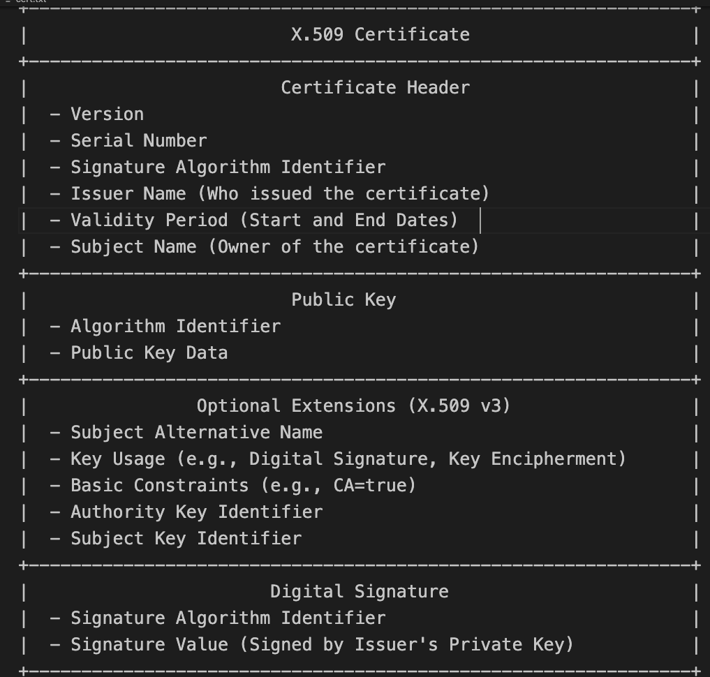
Certificates
We need a way to proof authenticity
Generate a pair of public/private key
Put a public key in a certificate
Put the website name in the certificate
Sign the certificate with the private key
Meet x509

Slide 10
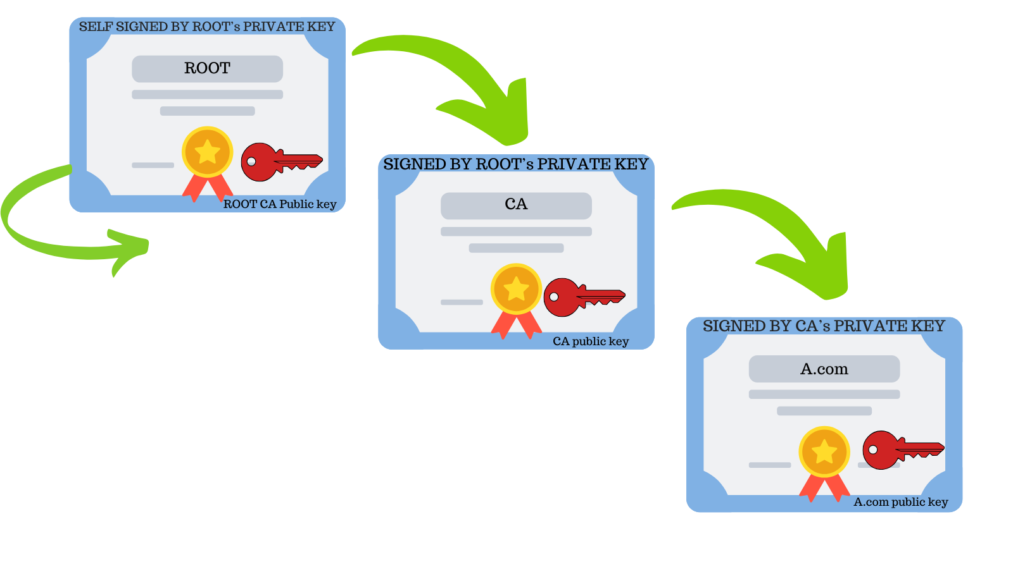
Certificates
Certificates can be “self signed”
Ie private key signing the cert belong to the public key
Usually untrusted and used for testing/local
Certificates can sign “other certificates”
Creating a trust chain
Issuer name is who issued it
Lets encrypt
Ultimately a ROOT cert is found
ROOT certs are always self signed
They are trusted by everyone
Installed with OS root (certificate store)

Slide 11
Certificate Verification
X509
Name: A.com
Issuer: CA
PublicKey: APB
Sign: CAPRK*
X509
Name: CA
Issuer: RootTrust
PublicKey: CAPB
Sign: RootTrustPRK*
X509
Name: RootTrust
Issuer: RootTrust
PublicKey: RootTrustPB
Sign: RootTrustPRK*
Client receives the full chain, wants to verify A.com cert signature which as been signed by CA public key issuer, so it gets the CA and gets the CAPUB to verify, but also it needs to trust the CA cert so it, verifies that by getting the RootTrust public key and verifies it, but the RootTrust is self signed so it looks up its local cert store. If it is there it is trusted. Else rejected.

Slide 12
TLS
Transport Layer security
Encrypt using the same key on both client and server
For that we need to exchange the key
We use public key encryption to exchange key
We share certificate for authentication

Slide 13



TLS 1.2
(RSA)
open
close
RSA Public key
RSA Private key
Client hello
Server hello (cert)
Change cipher, fin
Change cipher, fin
GET /
Headers+ index.html
<html>...
….

Slide 14
Problems with that approach
Encrypting the symmetric key with public key is simple
But its not perfectly forward
Attacker can record all encrypted communications
If the server private key is leaked (heart bleed)
They can go back and decrypt everything
We need ephemeral keys! Meet Diffie Hellman

Slide 15
Diffie Hellman
Let us not share the symmetric key at all
Let us only share parameters enough to generate it
Each party generate the same key
Party one generates X number (private)
Also generates g and n (public, random and prime)
Party two generates Y number (private)
Public g,n
Private X
Private Y

Slide 16
Diffie Hellman
Party 1 sends g and n to Party 2
Anyone can sniff those values fine.
Now both has g and n
Public g,n
Public g,n
Private X
Private Y

Slide 17
Diffie Hellman
Party 1 takes g to the power of X % n
g ^ X % n is now a public value
Cannot be broken to get X!
Party 2 does the same with Y
g ^ Y % n is now a public value
Cannot be broken to get Y
Both parties share the new values
g^x % n
Public g,n
Public g,n
Private X
g^y % n
Private Y

Slide 18
Diffie Hellman
Party 1 takes Y’s value and raise it to X
(g^y % n)^x = g^xy % n
Party 2 takes X’s value and raise it to Y
(g^x % n)^y = g^xy % n
Both now has the same value g^xy % n
This is the used as a seed for the key g^xy % n
Public g,n
g^x % n
Public g,n
Private Y
Private X
g^y % n
(g^y % n)^x = g^xy % n
(g^x % n)^y = g^xy % n

Slide 19

More problems! MITM
This solves perfect secrecy
But what if someone intercepts and put their own DH keys
MITM replace Y’s parameter with their own
X doesn’t know that happened (it's just numbers)
Public g,n
g^x % n
Public g,n
Private Y
Private X
g^z % n
g^y % n
(g^z % n)^x = g^xz % n
(g^x % n)^y = g^xy % n
(g^x % n)^z = g^xz % n
Private Z

Slide 20
Solved with signing
We bring back public key encryption
But only to sign the entire DH message
With certificates

Slide 21


TLS1.3
open
close
Public key
g,n
Private key
(g^X % n)
X
(g^y % n)
g,n
Entire message Signed with private key! (we don’t sent PK)
{
}
Y
(g^y % n)
(g^x % n)
+
(g^x % n)^y = g^xy % n
(g^y % n)^x = g^xy % n
GET /
index.html
<html>...
Client verifies the message is indeed signed by Y by using public key in certificate

Slide 22
There is more to TLS
More stuff is sent in the TLS handshake
TLS extensions
ALPN
SNI
Cipher algorithms
Key generation algorithms
Key size
Digital signature algorithms
Client side certificates

Slide 23
Node HTTPS
Node HTTPS Server requires a certificate and private key
The rest is the same
More work though!
Requests gets hit with additional cost
Responses gets hit with additional cost

Slide 24
Generate Private key and Certificate with OpenSSL
OpenSSL is a library for cryptographic operations
Generate private key
openssl genrsa -out private-key.pem 2048
Generate Certificate x509 (which contains public key)
openssl req -new -x509 -key private-key.pem -out certificate.pem -days 365
Answer questions to fill the the 509 fields
Most important is common name , subject alternative which is the website

Slide 25
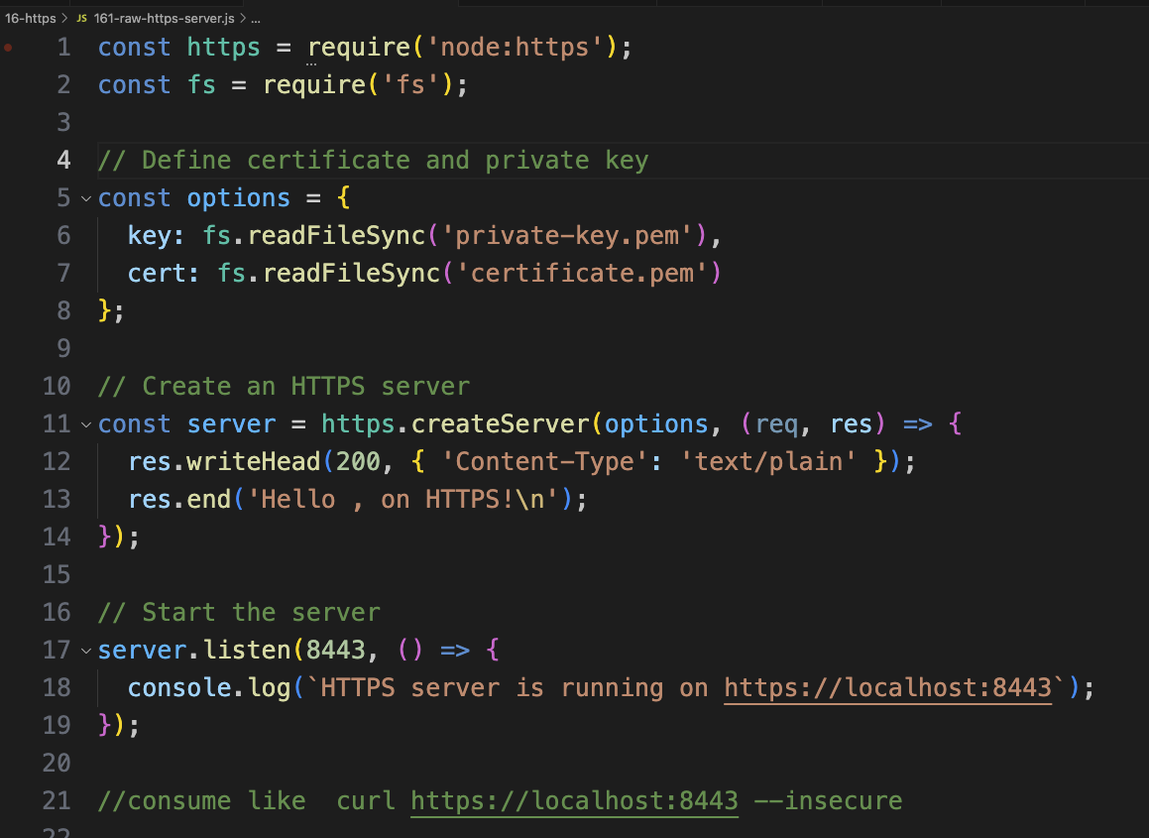
Example Server
We pass in our private keys (secret don’t leak it!)
We pass the certificate
Request is decrypted before we get here
Response is encrypted right after this

Slide 26
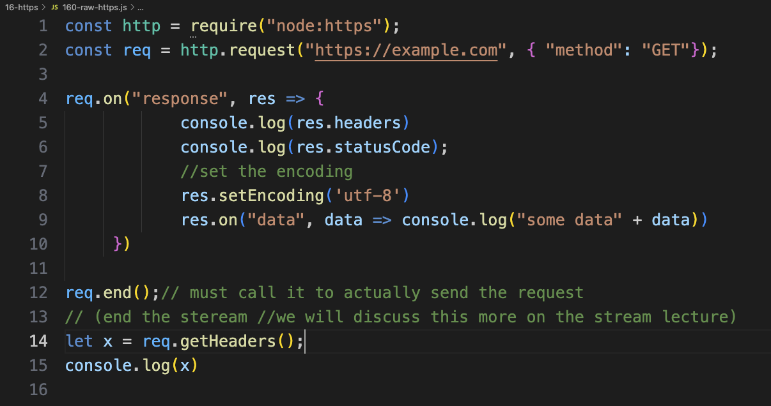
Example Client
New module that knows how to do https
https scheme
Response is decrypted before we get here
Request is encrypted right after this

Slide 27
Summary & Demo
Encryptions
TLS
Certificates
Node HTTPS
Code exercise →
raw https request
Create a certificate/private/public key
Raw https server

